Slide 1
MPI UNIT 3

Slide 2
80286

Slide 3
Descriptors
Descriptors carry all the relevant information regarding a segment and its access rights
It has Segment descriptors for code, stack and data segments as basic descriptors
It has control descriptors for control transfer operations.

Slide 4
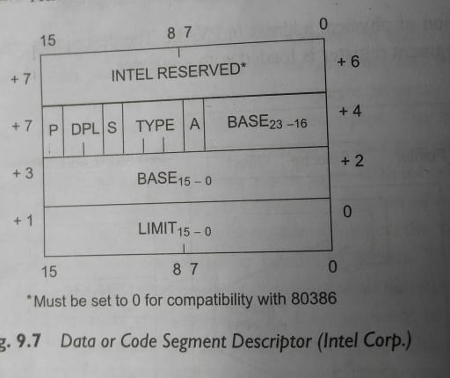
Data or code segment descriptor
The information stored in 8-bytes of a descriptor can be used by OS to support implementation of memory management and protection schemes.

Slide 5
Requesting program tries to access the program segment.
For accessing any program segment or page ,its descriptor is first accessed and its access rights byte contents are verified with those of requesting program.
The base and limit field used to find physical address of program segment.

Slide 6
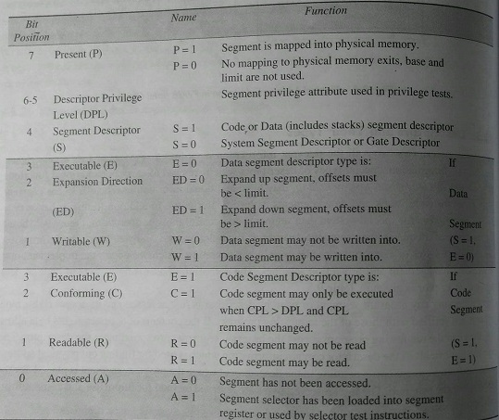
Access Rights Byte

Slide 7
System segment/Gate descriptors
S=0
Used to store system data and execution state of task mainly used in multi tasking.
Type 1-3 are system segment descriptors
Type 4-7 are Gate descriptors

Slide 8
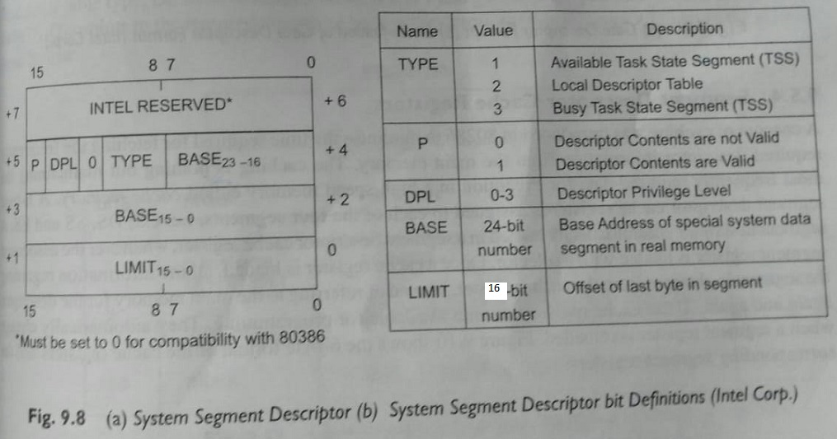
system segment descriptors

Slide 9
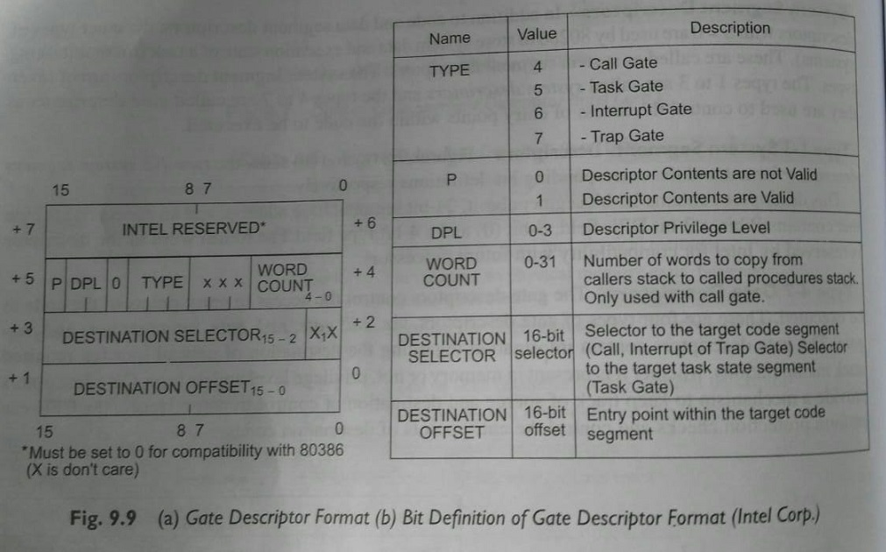
Gate descriptors
Contains information about destination of control transfer ,required stack manipulations, privilege level and its type .
Call gate used to alter privilege level
Task gates used to switch from one task
to another task
Interrupt and trap gates are used to
specify corresponding services.

Slide 10
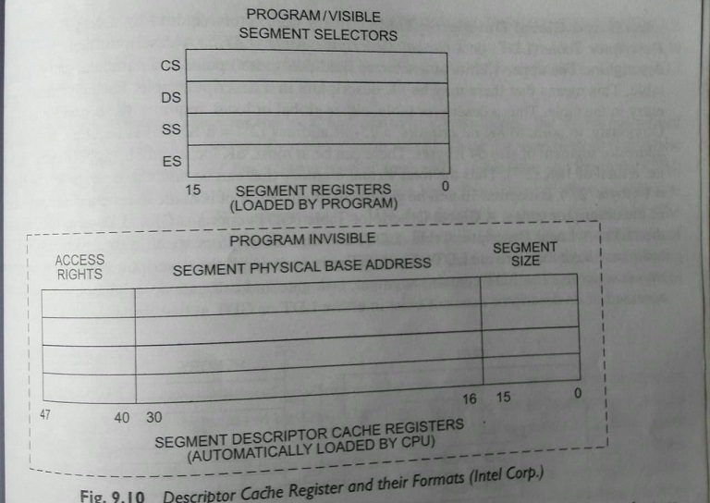
Segment descriptor Cache register

Slide 11
Local and Global Descriptor Table
Descriptor table is array of 8K descriptors.
Upper 13 bits point to particular entry in descriptor .
And each descriptor size is 8 bytes.
Thus descriptor table requires 64KB of memory .
GDT will contains descriptors common to all the tasks
LDT contains descriptors specific to particular task.

Slide 12
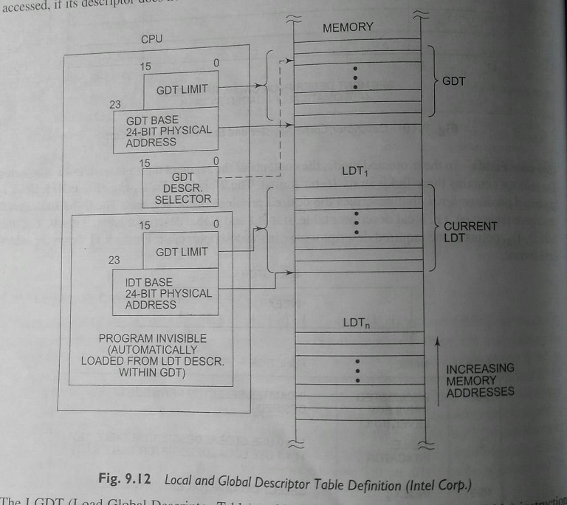

Slide 13
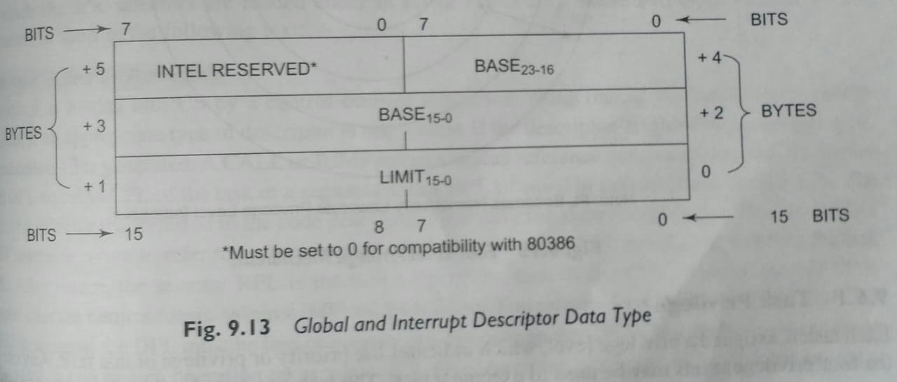

Slide 14
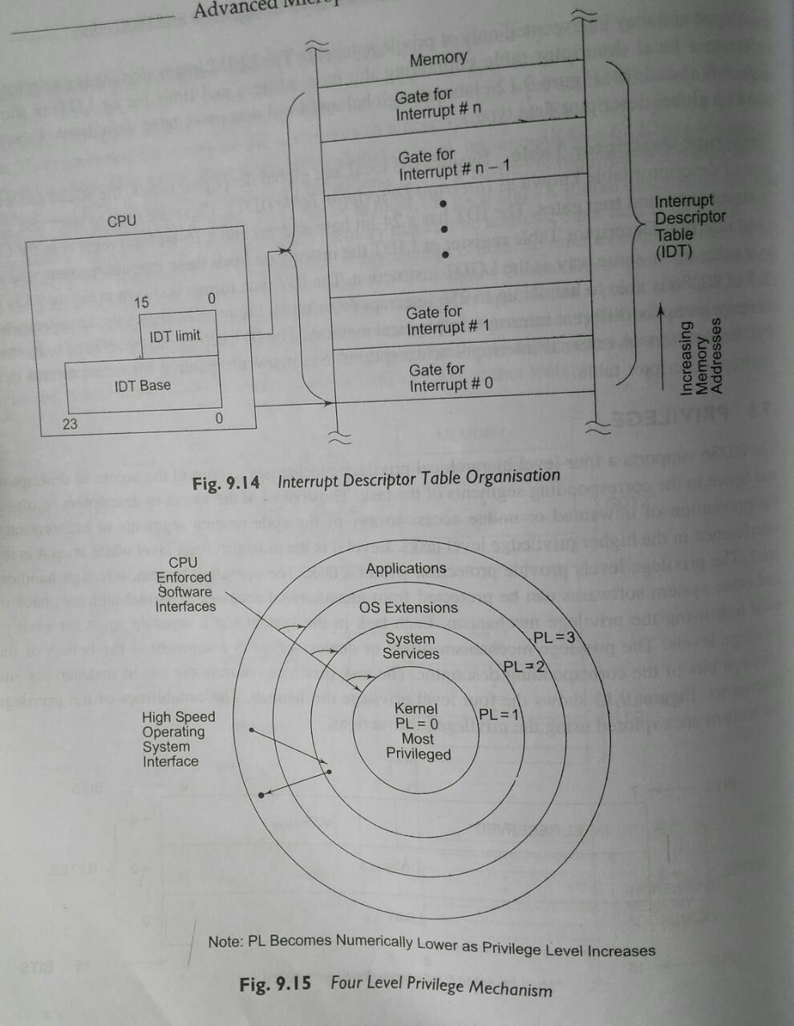
Interrupt descriptor table
Used to store task gates, interrupt gates, trap gates.

Slide 15
Privilege
Control of access to descriptor results in prevention of unwanted access to any segment.
Level 0 is most privilege level
Level 4 is least privilege level

Slide 16
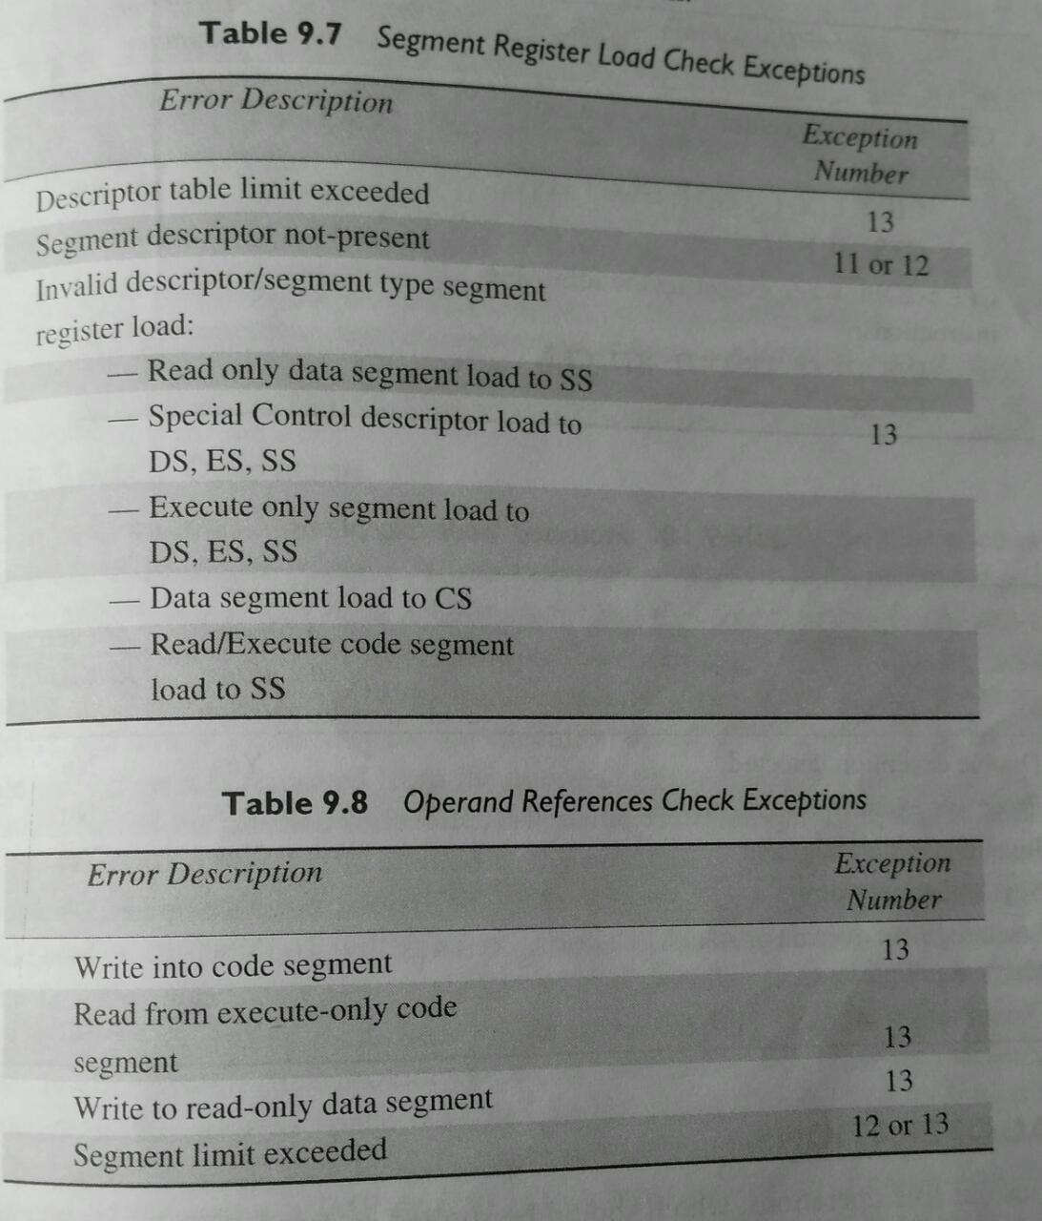
Exceptions in protected mode

Slide 17
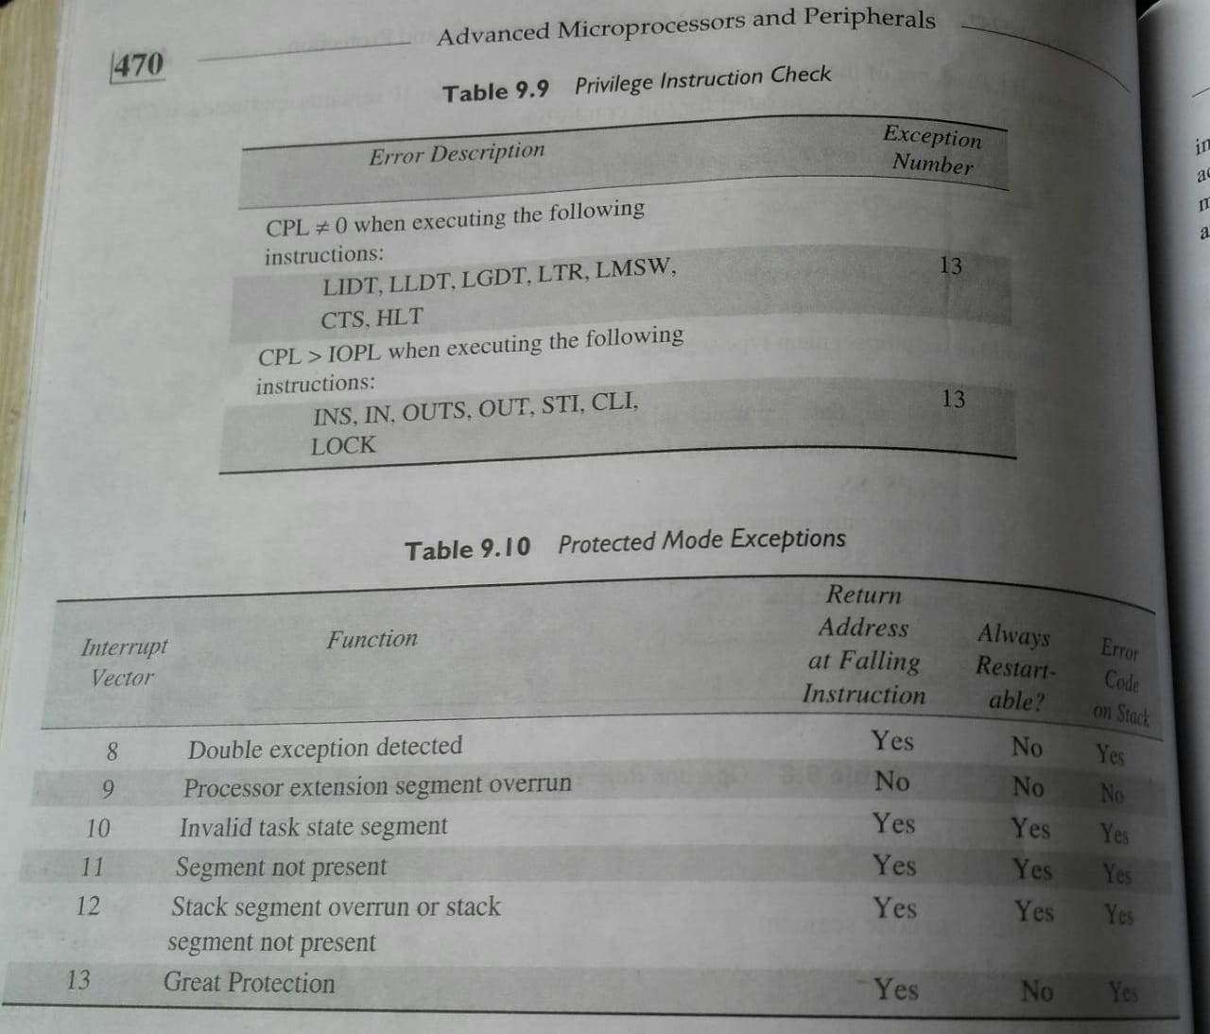

Slide 18
80386
The Memory management unit consists of a Segmentation unit and a Paging unit.
Segmentation unit allows the use of two address components, viz. segment and offset for relocability and sharing of code and data.
Segmentation unit allows segments of size 4Gbytes at max.
The Paging unit organizes the physical memory in terms of pages of 4kbytes size each.
Paging unit works under the control of the segmentation unit, i.e. each segment is further divided into pages. The virtual memory is also organizes in terms of segments and pages by the memory management unit.
Paging unit converts linear addresses into physical addresses.

Slide 19
Real Address Mode of 80386
After reset, the 80386 starts from memory location FFFFFFF0H under the real address mode. In the real mode, 80386 works as a fast 8086 with 32-bit registers and data types.
In real mode, the default operand size is 16 bit but 32- bit operands and addressing modes may be used with the help of override prefixes.
He segment size in real mode is 64k, hence the 32-bit effective addressing must be less than 0000FFFFFH. The real mode initializes the 80386 and prepares it for protected mode.

Slide 20
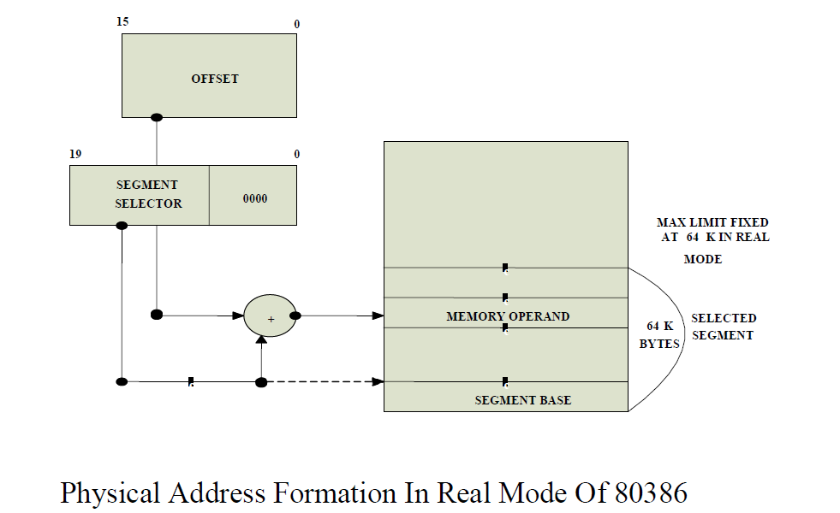

Slide 21
Memory Addressing in Real Mode: In the real mode, the 80386 can address at the most 1Mbytes of physical memory using address lines A0-A19.
• Paging unit is disabled in real addressing mode, and hence the real addresses are the same as the physical addresses.
• To form a physical memory address, appropriate segment registers contents (16-bits) are shifted left by four positions and then added to the 16-bit offset address formed using one of the addressing modes, in the same way as in the 80386 real address mode.
• The segment in 80386 real mode can be read, write or executed, i.e. no protection is available.

Slide 22
Any fetch or access past the end of the segment limit generate exception 13 in real address mode.
The segments in 80386 real mode may be overlapped or non_overlapped.
The interrupt vector table of 80386 has been allocated 1Kbyte space starting from 00000H to 003FFH.

Slide 23
Protected Mode of 80386
All the capabilities of 80386 are available for utilization in its protected mode of operation.
The 80386 in protected mode support all the software written for 80286 and 8086 to be executed under the control of memory management and protection abilities of 80386.
The protected mode allows the use of additional instruction, addressing modes and capabilities of 80386.
• ADDRESSING IN PROTECTED MODE: In this mode, the contents of segment registers are used as selectors to address descriptors which contain the segment limit, base address and access rights byte of the segment.

Slide 24
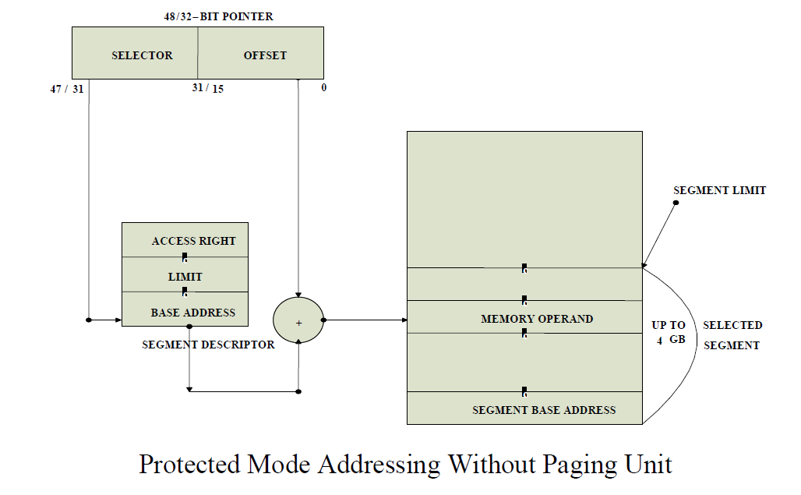

Slide 25
The effective address (offset) is added with segment base address to calculate linear address. This linear address is further used as physical address, if the paging unit is disabled, otherwise the paging unit converts the linear address into physical address.
The paging unit is a memory management unit enabled only in protected mode. The paging mechanism allows handling of large segments of memory in terms of pages of 4Kbyte size.
The paging unit operates under the control of segmentation unit. The paging unit if enabled converts linear addresses into physical address, in protected mode.

Slide 26
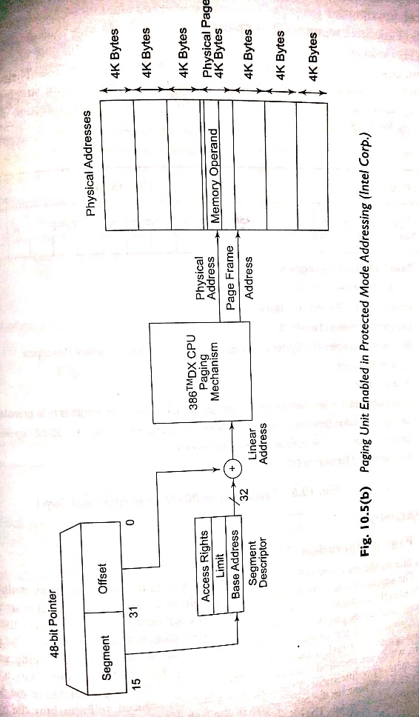
Protected mode addressing with paging

Slide 27
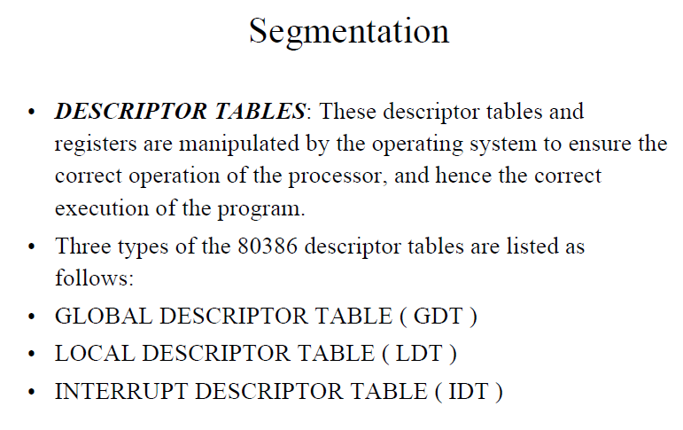

Slide 28
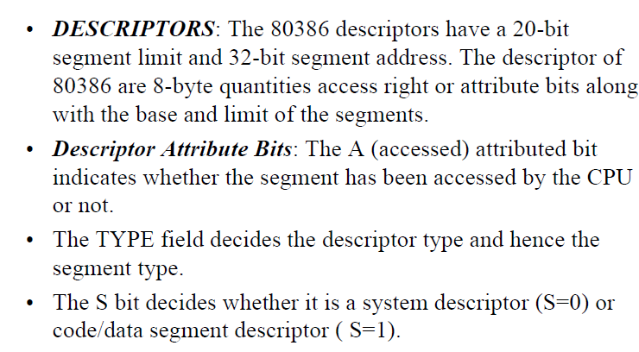

Slide 29
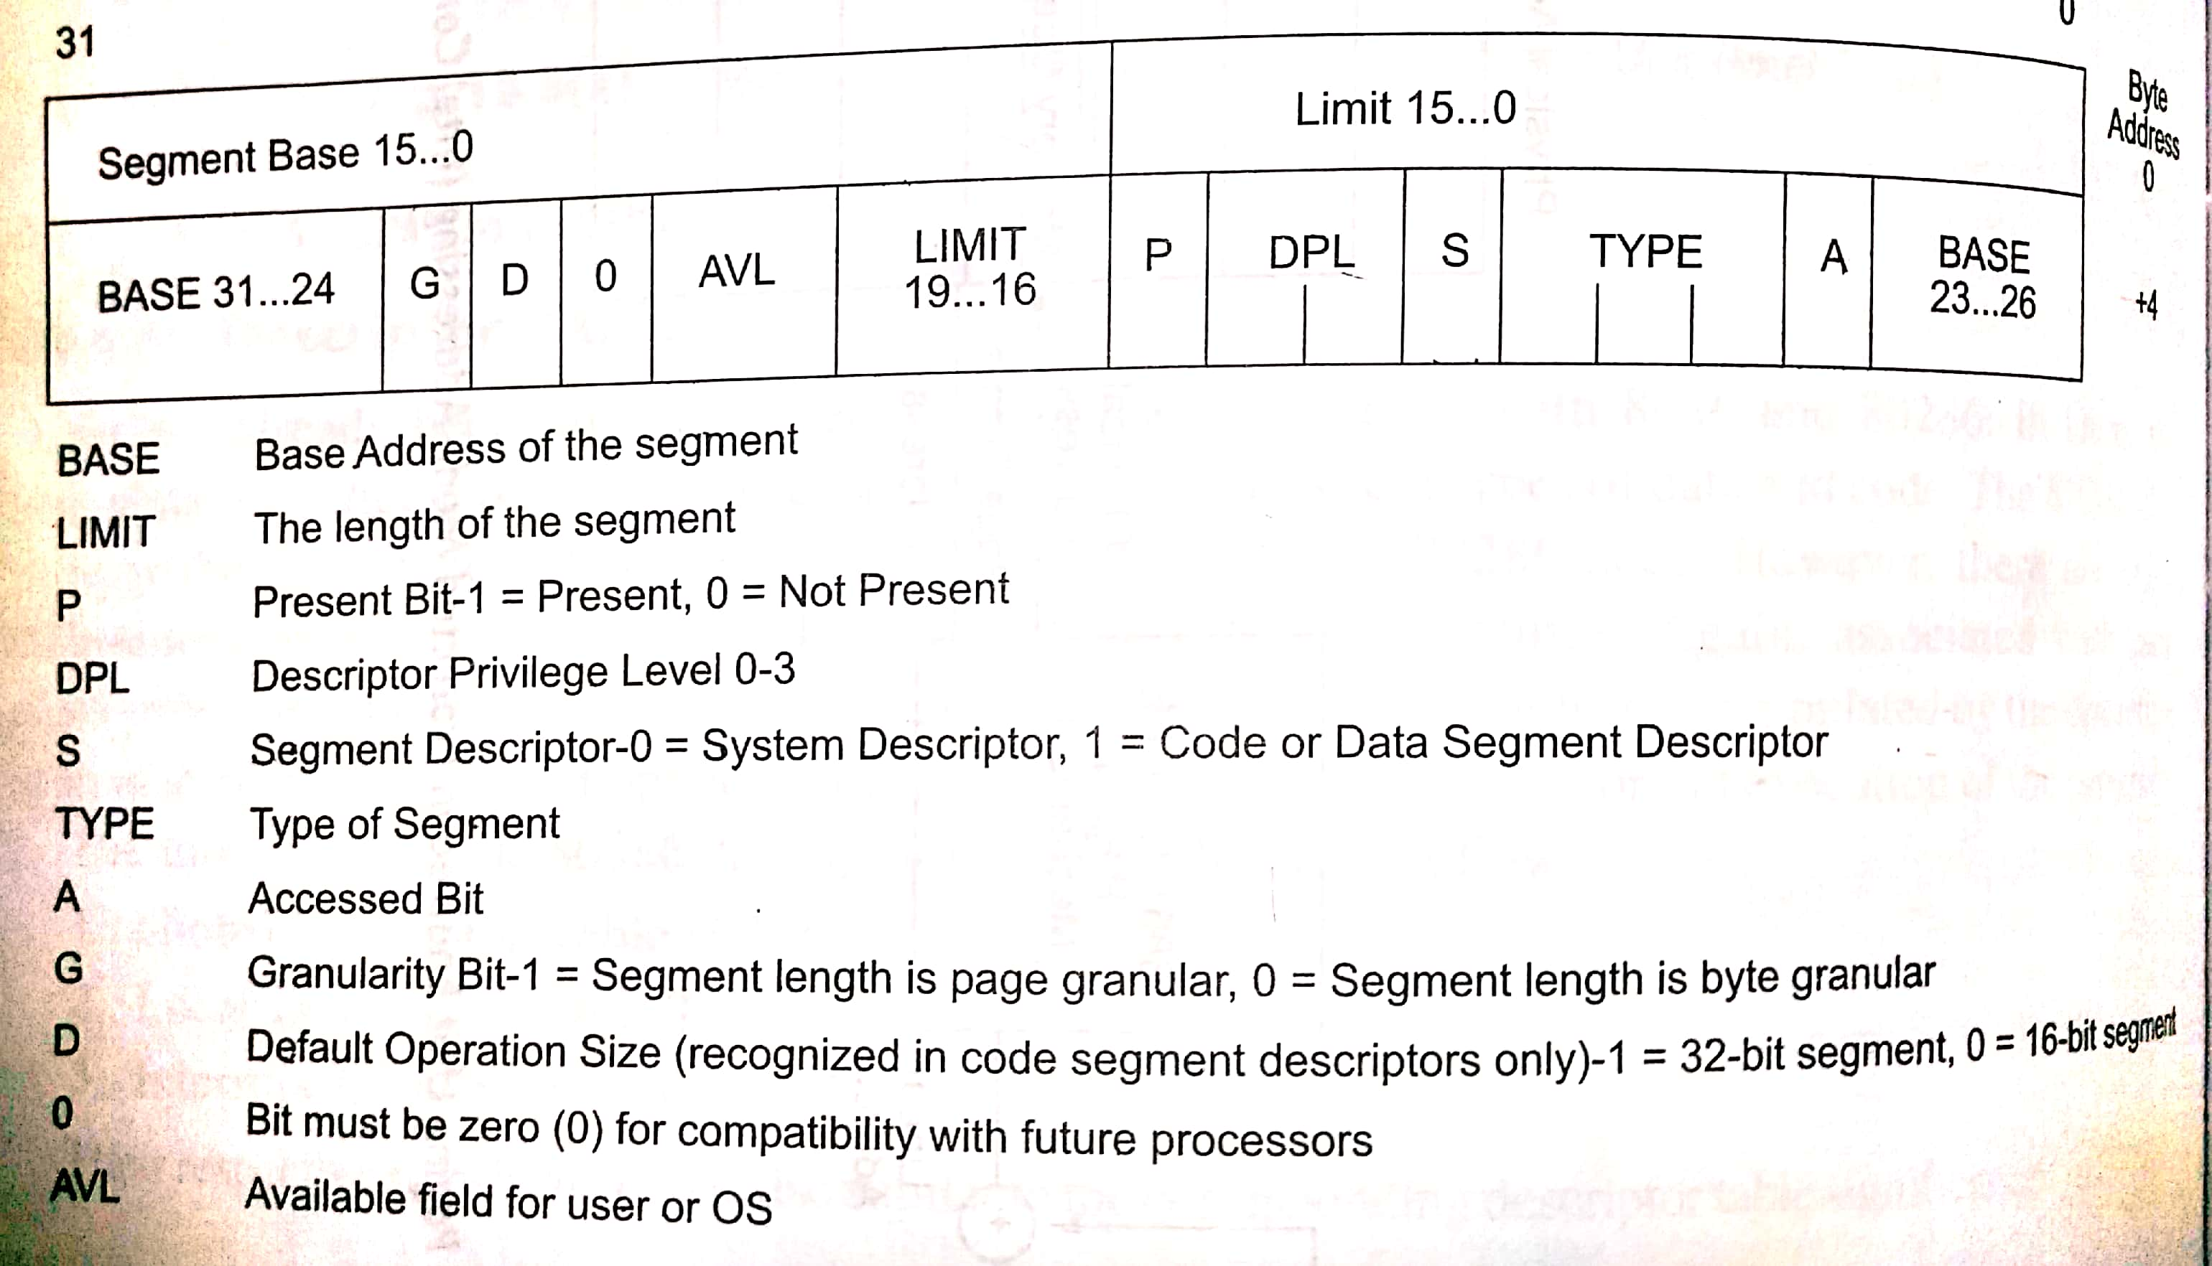
80386 descriptor

Slide 30
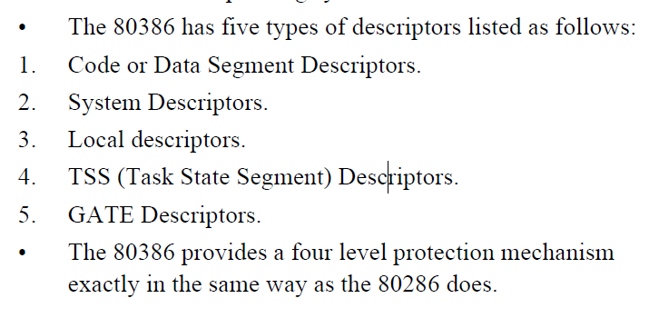

Slide 31
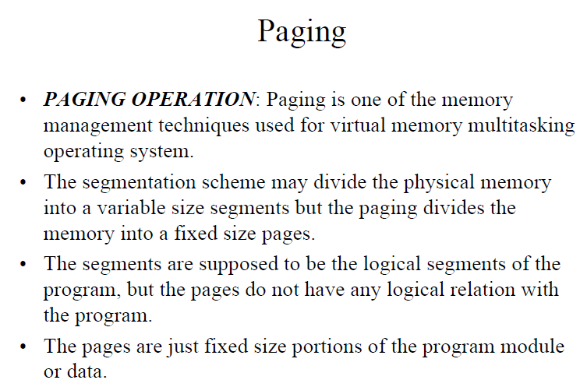

Slide 32
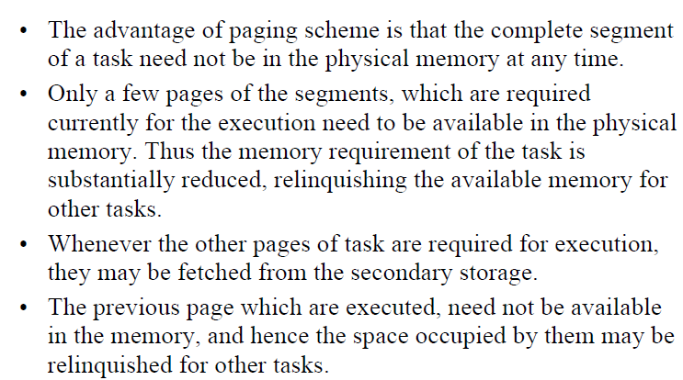

Slide 33
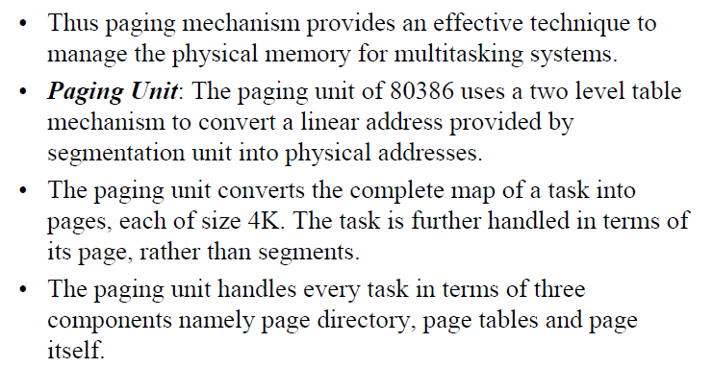

Slide 34
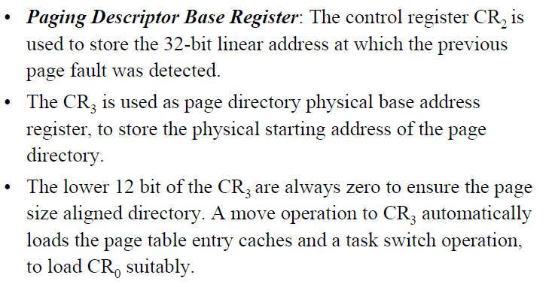

Slide 35
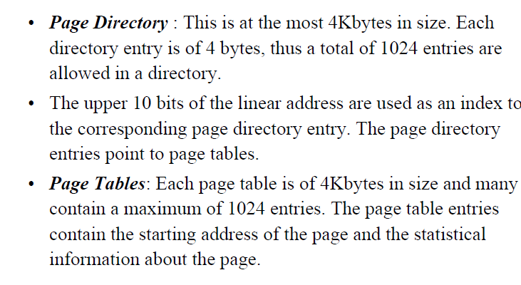

Slide 36
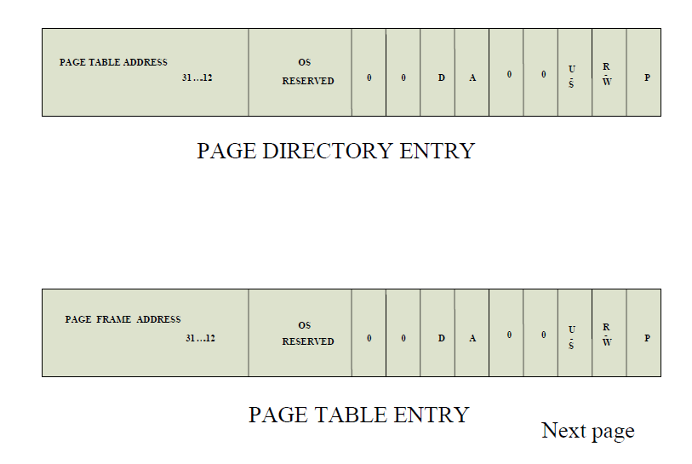

Slide 37
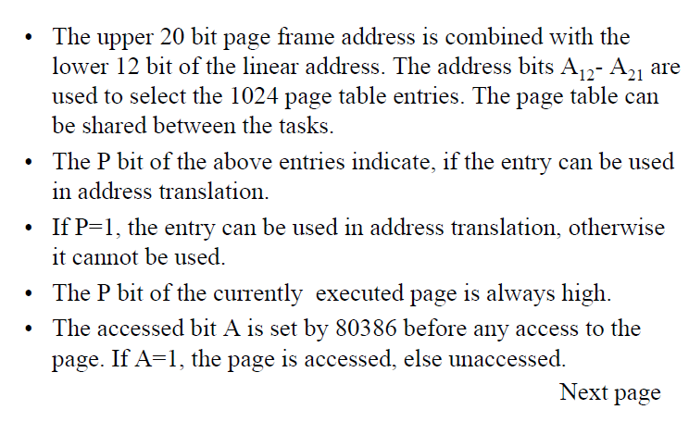

Slide 38
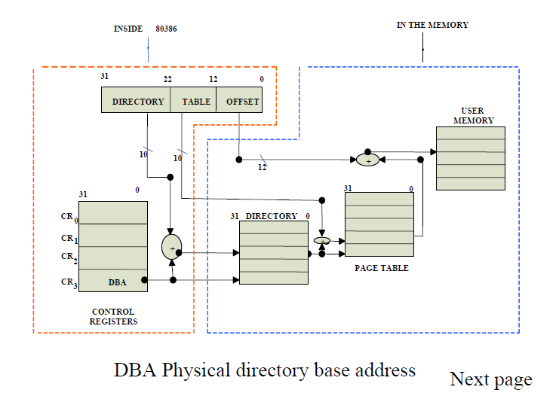

Slide 39
